Slide 1

EECS 4413 ASSIGNMENT 1
Instructed by: Prof. Jack Jiang
Presented by: Zhongran (Julian) Deng
Sied Hoa (Heny) Tjin
Hashim Al-Helli
Randy Agyapong
David Iliaguiev

Slide 2
BIG DATA
Internet generates data everyday at a petabyte scale.
This includes structured data and unstructured data.
Big data is a collection of large datasets that cannot be processed using traditional computing techniques.
It is not a single technique or a tool. It involves many areas of business and technology.

Slide 3

WHAT IS HADOOP?
Feature:
Open source
Break through the limit of traditional database
Support commodity computing
High scalability
Hadoop is an open-source software framework to process and store big data.
Notes:
Commodity computing is the use of large numbers of already-available computing components for parallel computing

Slide 4
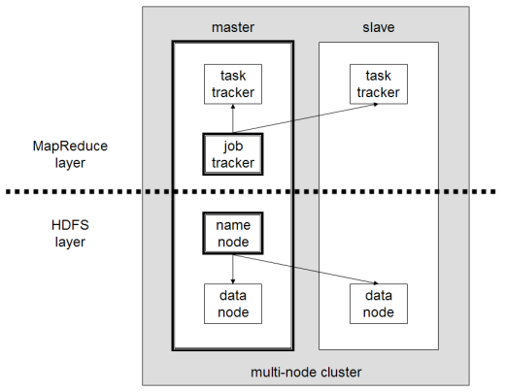
TYPICAL ARCHITECTURE OF HADOOP
HDFS – distributed file system.
Map reduce – offline computing engine.
As versions updates, Hadoop is gaining more function modules such as Yarn which improves the performance of Hadoop.
Master-slave diagram
Notes:
In today’s presentation, our team will mainly focus on HDFS, Map Reduce and Yarn. We will also cover Hadoop’s ecosystem in the last section.

Slide 5
HDFS
A distributed file system for Hadoop

Slide 6
TRADITIONAL VS. HDFS
Each block of data is small.
Approximately 51 bytes.
Huge amount of I/O operations while reading large data.
Each block of data is large.
By default 64MB and could be more.
Reading large data sequentially after single seek operation.
Notes:
Restricts file format diversity. Consume processing power. Save processing power

Slide 7
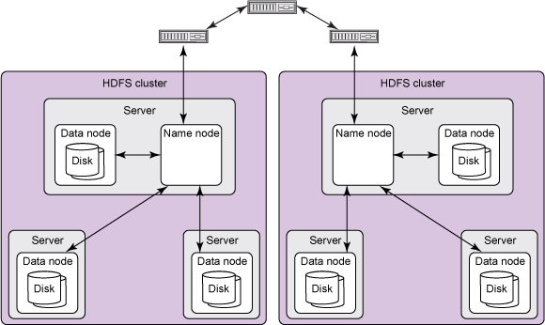
HDFS ARCHITECTURE -HADOOP 1.0
A typical HDFS cluster contains a single name node plus a cluster of data nodes
The server holding the name node is very crucial as there is only one existing per cluster.
Data nodes belong to name node and it can be stored in different server.

Slide 8
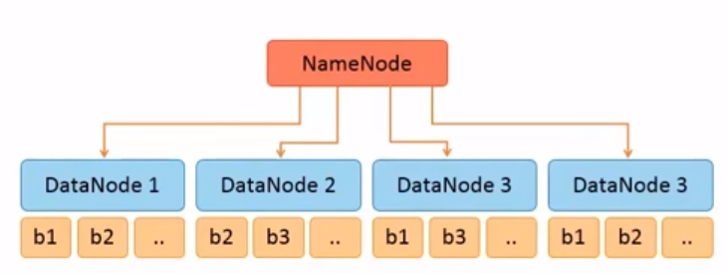
NAME NODE
Stores metadata and information of the file system.
Knows the data is stored in which certain data node.
In early version, it was a single point of failure, that means, if the name node becomes unavailable ,the whole cluster goes down.

Slide 9
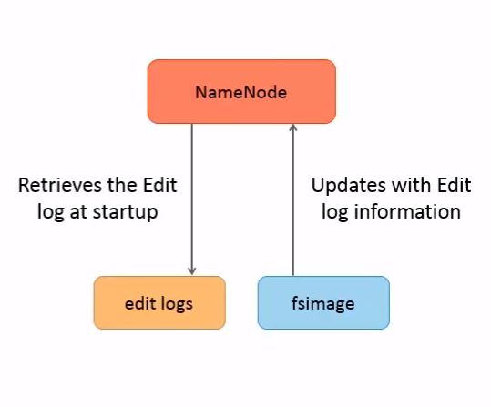
NAME NODE
Name node holds two persistent files which are transaction log called edit logs and namespace image called fsImage.
Edit logs records changes of metadata.
Fsimage keeps the information of the entire file system namespace.
Notes:
Creating new file; mapping of blocks and file property.

Slide 10
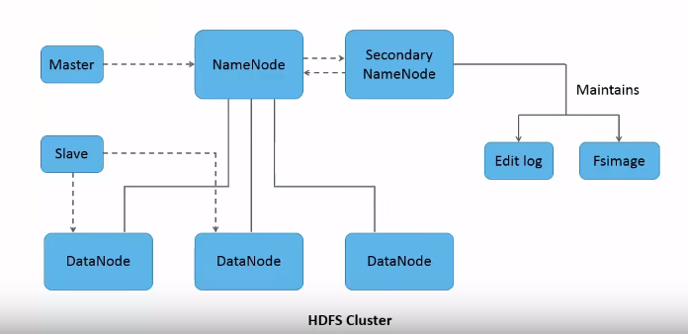
SECONDARY NAME NODE
Not a backup daemon for name node.
Maintains edit logs and fsimage.
Helps to lower down name node’s restart time.

Slide 11
DATA NODES
Stores and maintains data blocks.
Responsible to store and retrieve data blocks upon request from name node or the client.
There can be N numbers of data nodes depending on the system requirement.
Perform operations such as read, write, block creation, deletion, replication, etc.

Slide 12
DATA BLOCK
Each file is split into one or more blocks stored and replicated in data nodes.
By default, each block is 64MB.
The size can be increased to 128MB or bigger.
Notes:
Point 3 try to shorten the sentence and explain it in presentation
Point 1 remember to say that replication is for fault tolerance principle where data are stored in many datanodes in case one datanode goes down
The size can be increased to 128MB. Doing this can reduce the pressure on name node’s memory. However, this will also reduce computation parallelism as the number of blocks per file decreases.

Slide 13

DATA BLOCK REPLICATION
The data blocks are replicated for fault tolerance.
The data blocks are distributed in data node system within the cluster and thus ensures the replica of data is maintained.
Rack-awareness.
Notes:
Typically, large HDFS clusters are arranged across multiple installations (racks). Network traffic between different nodes within the same installation is more efficient than network traffic across installations. A name node tries to place replicas of a block on multiple installations for improved fault tolerance. However, HDFS allows administrators to decide on which installation a node belongs. Therefore, each node knows its rack ID, making it rack aware.

Slide 14
INTERACTION OF EACH COMPONENTS
All HDFS communication protocols build on the TCP/IP protocol.
Client communicate with the name node using a proprietary RPC (Remote Procedure Call)-based protocol.
Each data node serves up blocks of data over the networking using block protocol specific to HDFS.

Slide 15
WEAKNESS OF HDFS IN HADOOP 1.0
Single point of failure. Once name node is unavailable, the whole cluster goes down.

Slide 16
HDFS ARCHITECTURE-HADOOP 2.0+
Running two name nodes.
The back-up name node is in the same cluster.
Each name node is configured as Active/Passive. Only one name node is in Active stat.

Slide 17
MAPREDUCE ENGINE IN HADOOP VER. 1
CLIENT
JOB TRACKER
TASK TRACKER
Client submit MapReduce Jobs.
Job Tracker will push work out (to available task-tracker nodes)
Every task tracker node will spawn JVM (Java Virtual Machine) process
At a set frequency, the task tracker will send signal to Job Tracker to indicate its ‘liveliness’
Notes:
1. Client submit MapReduce Jobs.
2. Job Tracker will push work out (to available task-tracker nodes):
1. Keep work as close to the ‘targeted’ data as possible
(this is possible due to rack-aware file system)
To Julian: do you refer this location awareness of the file system as rack-aware file system?
(with rack-aware file system) Job Tracker can know which
(a)node contains the data
(b)which other node nearby the system
2. if work cannot be hosted on the same node as the data it is processing, Task Tracker will assign to the node nearest to the data, i.e that’s in the same rack
Basically, the pushing of the job (scheduling) is processed with the objective of:
Reducing network traffic on the main backbone network
→ performance critical: This is crucial, since if one of the job tracks slow down, the entire MapReduce Job slows down as well, especially if it is the last piece of information.
(at Task Tracker). Every task tracker node will spawn JVM (Java Virtual Machine) process
→ Objective: Should the job crashes its environment, it will be its JVM, and hence avoiding crashing the Task Tracker
3b. At a set frequency, the task tracker will send signal to Job Tracker to indicate its ‘liveliness’
→ Should Task-tracker fails or has reached time-out (Job Tracker will know this when it does not receive any signal from task tracker for a certain period of time),

Slide 18
MAPREDUCE ENGINE IN HADOOP VER. 1
2
Task Tracker
CLIENT
4
1
Task
Task
3
Client submit MapReduce Jobs to JobTracker.
Job Tracker push jobs to TaskTrackers
JobTracker report progress to Task Tracker.
Job Tracker support only Map jobs and Reduce Jobs
Job Tracker
5
Task Tracker
CLIENT
Task
Task
Task Tracker
Task
Task
Notes:
-- need to shorten description into few words, and explain during presentation
Client submit MapReduce Jobs to monolithic Job Tracker.
Job Tracker assigns and schedules cluster resources for the users’ jobs, usually taking int account the data locality (which JobTracker get from NameNode)
Job Tracker works with Task Trackers on cluster nodes in collecting status data and monitoring progress. Should a node go down, Job Tracker can reschedule jobs.
Job Tracker support only Map jobs and Reduce Jobs
Once a job is complete, Job Tracker releases the resources and makes them available for other work

Slide 19
MAPREDUCE ALGORITHM
Split()
(K1, V1)
Map()
List (K1, V1)
Shuffle()
(K3, list( V3))
Reduce()
(K4, V4)
a Node
File
a Node
a Node
Result
a Node
File
Notes:
Reduce( Map( ( Split(input) ) ) )
Split (Input): Input → Input List:
One big chunk of data → a number of split data
Place data in distributed file system, HDFS
→ data is automatically sliced, placed on different nodes/servers.
Map(Input List): Input List → Output List
Mapping: a user query/job is ‘mapped’ to all nodes == applied to all slices independently.
Reduce(Output list): Output List → Output value
Results are reduced to one answer
Features of this mechanism:
Functional approach:
Original data doesn’t change (MapReduce process only create new data.
Intermediate data doesn’t change.
Single one way communication path from mapper to reducer
Process is transparent to end user.
Hence user doesn’t need to specify communication and data movement in the process
MapReduce programming paradigm – break into two basic phases: MAP and REDUCE
MAP Phase :
known as mappers, Java processes JVMs
Usually JVMs start up on nodes that contain the data they will process.
Apply principle of Data locality == Moving the processing to servers that contain the data is more efficient than moving data across the network.
Mappers process input in key-value pairs, only able to process a single pair each time.
Number of mappers set by framework , not developer
After mapper has processed input data, output is key-value pair, which is the input for next phase, Sort and Shuffle
The output key-value pairs of mappers, is pass to Reducer.
Mappers can’t pass information to other mappers, (so is reducer cannot communicate with other reducer)
Example of processes performed in mappers: parsing, transforming, filtering
Sort and Shuffle Phase (currently just the basic)
data is sorted and partitioned.
after which, data is sent, over network, to reducers JVMs
Reducer Phase
Reducer read the data ordered and partitioned by the keys
Reducer can do any number of operations on the data
Reducer most likely will write out some amount of data or aggregate to store like HDFS of HBASE
Each reducer typically, though not necessarily, has single output stream: by default a set of files in a single HDFS directory
Synchronization barrier
Other Notes:
Mappers and reducers typically don’t’ use much memory
JVM heap size is set relatively low
the output of mapper and reducer is written to disk
book pg 80-81
How?
Dont understand what it means
Synchronization Barrier of reducer, and its efficiency:
If output of reducers require further processing, entire data will be written to disk again, and read again.
It is considered inefficient for iterative processing of data
Downside of MapReduce process for iterative algorithms:
Start up time: a loss of 10-30 seconds to startup cost
MapReduce writes to disk frequently in order to facilitate fault tolerance
book pg 82
find out why

Slide 20
SHARE NOTHING ARCHITECTURE IN HADOOP MAPREDUCE
Each node is independent of other nodes in the system
No share resources that can become bottlenecks
Lack of shared data: each node is processing distinct subset of data, hence no need to manage access to shared data
Advantages:
Easily manage workflow (associated with transparent process feature)
Scalable: No shared resources, hence addition of nodes adss resources to the system and does not add further contention. As input data increases, just need to apply more nodes (linear scalability)
Fault tolerant:
each node/server is independent, hence no single points of failure
Failed process in one node can be restarted on other node.
The system can support multiple failures, depending number of data replication. (by default it is set to 3 replication)
Hence hardware failure will only slow down process, but not entirely crash the whole job
Inputs are immutable. Hence result can be recalculated

Slide 21
ISSUES WITH MAPREDUCE IN VERSION 1
Scalability: - Max cluster size is fixed (4000 nodes) - Max concurrent tasks is fixed (40,000 processes) - Coarse synchronization in Job Tracker limited scalability
Availability: If job tracker fails, all queued and running jobs are killed
Resource Utilization: Fixed/Static allocation of resources for map and reduce process results in low resource utilization
Ability to support for Alternate Programming paradigms and Services: - Non-MapReduce Applications are needed

Slide 22
PRINCIPLE OF APACHE HADOOP SYSTEM
Moving computation is cheaper than moving data.
Effectively process large volumes of information by connecting many commodity computers together to work in parallel making it cheaper to operate.
Designed with fundamental assumption that hardware failure is ‘common’, and it is the job of the system to handle hardware failure automatically by the platform.
Notes:
Point 1 explaination: keeping data disk (!= moving blocks of data to server) provides faster performance.
Point 2 explaination:
This solves the problem of botttleneck of a single disk drive (by applying the same tasks to many disks, each holding a different portion or slice of the overall data)
Porint 3
(Self-healing).
Hence self-healing is crucial to have tasks continue working.
Hadoop is designed to use large number of commodity servers for computation and storage. As number of machines increases, so does the probability of server failure.

Slide 23
HADOOP 2.0- YARN
- YARN framework and Next Generation MapReduce (MRv2): YARN provides better resource management in Hadoop, resulting in improved cluster efficiency and application performance. It’s a pure scheduler.
- MapReduce Becomes User library or one of the application that runs inside YARN for cluster services.
Notes:
There are additional features such as Data Snapshot, Support for Windows, NFS access which will increase Hadoop adoption in the Industry to solve Big Data problems.
-- research more on hdfs federation
- HDFS High Availability (aka NameNode High Availability): In Hadoop 1.0 NameNode was the single point of failure in a Cluster, resulting in data loss in case of a NameNode failure. Hadoop 2.0 Architecture supports multiple Name Nodes to remove this bottleneck, making Hadoop attractive to enterprises.
- HDFS Federation: This feature allows horizontal scalability for Hadoop file system.

Slide 24
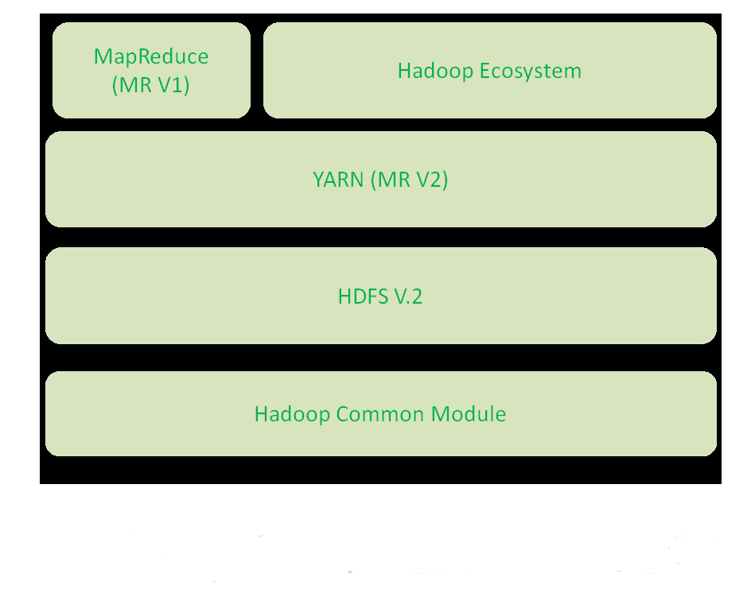
HADOOP 2 ARCHITECTURE
- The introduction of YARN as an alternative to MapReduce is a huge improvement to the product.
- HDFS was also modified to overcome problems of release 1.0
Notes:
http://cdn.journaldev.com/wp-content/uploads/2015/08/hadoop2.x-components.png

Slide 25
YARN (YET ANOTHER RESOURCE NEGOTIATOR)
- Provides all resources and resource management for the cluster.
- YARN separates MapReduce's job tracker and task tracker capabilities into separate entities, enabling Hadoop to support more varied processing approaches and a broader array of applications.

Slide 26
YARN COMPONENTS
- Resource Manager
- Application Master
- Node Manager

Slide 27
RESOURCE MANAGER
- Resource manager and node manager form the basis for managing applications in distributed manner
- the responsibility of the resource manager is to distribute the available resources to the applications using its scheduler, the scheduler performs the allocations according to constraints which can be user limits or queue capacities limits
- the scheduling is done based on the resource requirements of the applications

Slide 28
APPLICATION MASTER
- it negotiates resources from resource manager and works with node managers to execute and monitors the components tasks.

Slide 29
NODE MANAGER
- monitors resource usage of cpu, memory, disk, and network and report back to the resource manager

Slide 30
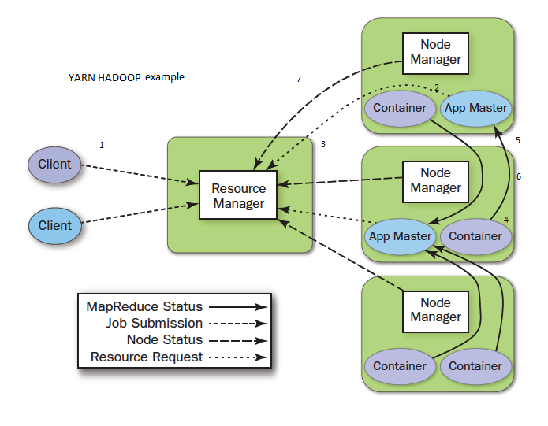
SIMPLE EXAMPLE OF YARN WITH DIAGRAM
Notes:
http://www.avante.es/wp-content/uploads/2016/04/Res-Manager.png
Client submit job
Resource manager selects node manager and instructs it to run its application master
Application master then tell the resource manager to get additional containers (resources)
Containers are started and managed by appropriate niode managers
Application master and conmtainers are connected then resource manager and node manager step away
The job progress is reported back to the application master
Once job is completed the node manager makes the resources available to use by another job

Slide 31
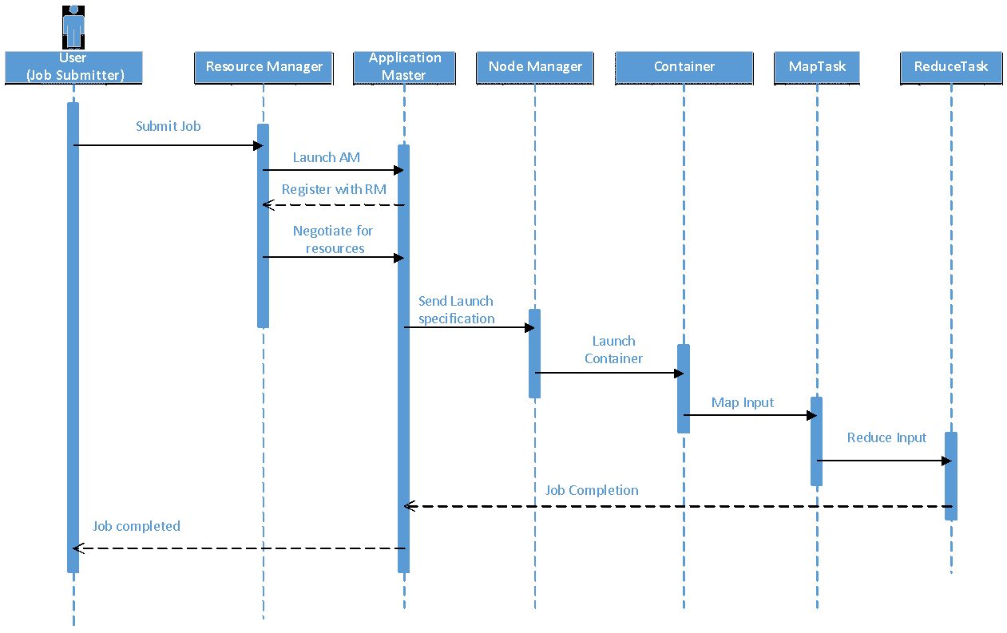
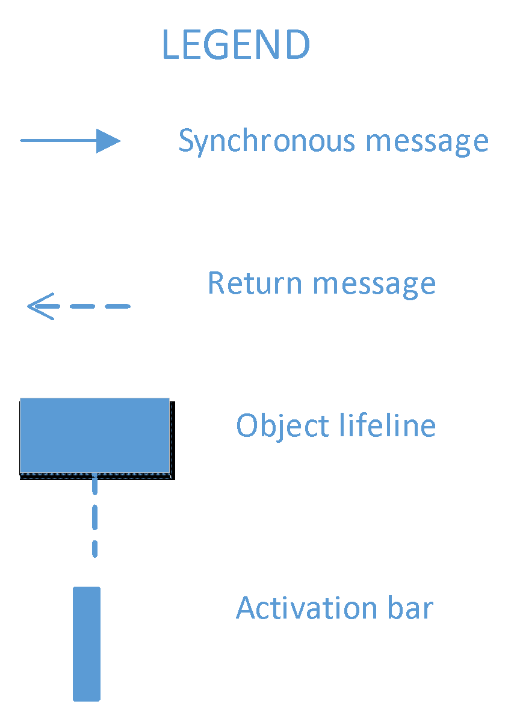
SEQUENCE DIAGRAM OF YARN AND MAPREDUCE

Slide 32
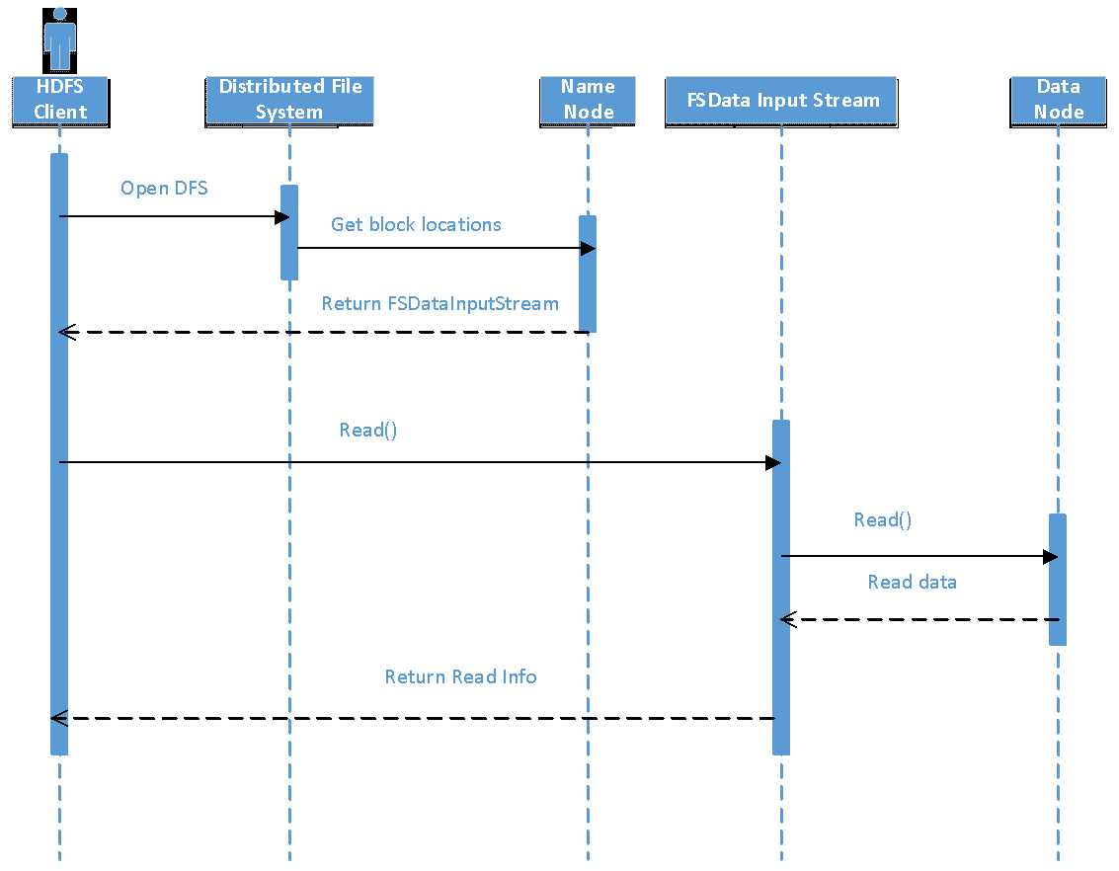
SEQUENCE DIAGRAM OF HDFS

Slide 33
APACHE HADOOP APP DEVELOPMENT
Hadoop has many ways for developers to create apps to interact with the system:
HTTP Browser
Client Local File System
FS Shell
Java applications
C applications

Slide 34
ACCESS
Developers can create websites for users to browse files of HDFS instances with an HTTP browser
Using NFS gateway HDF can be mounted as part of the client’s local file system
FS Shell is provided so that clients can access the HDFS through commands, this also allows for scripting languages to be used (i.e. Python)

Slide 35
DEVELOPMENT
Hadoop provides various Java APIs to interact with the system
HDFS provides a FileSystem Java API
Master REST API for MapReduce
Jobs API and Tasks API
YARN web services REST API
Hadoop Auth API
CredentialProvider API
C language wrapper for Java and REST API is also available

Slide 36
IMPLICATIONS FOR DEVELOPERS
Use of OO Language like Java to create applications for use with Hadoop allows for:
Modularity
Maintainability
Use of OODP(Object-Oriented Design Patterns)
The Layers of Hadoop (HDFS, MapReduce, YARN) allows for a division of resposibilities

Slide 37
LAYERS OF HADOOP
Developers can distribute work amongst themselves to operate independently and combine to create stable and robust software, groups focused on:
Access to HDFS can combine modules developed using the FileSystem Java API
Security can develop modules using Hadoop Auth API and CredentialProvider API
Status of application, jobs and tasks can develop modules using MapReduce REST APIs, they can also,
Split up resource management and job/task scheduling using the YARN REST APIs

Slide 38
HADOOP ECOSYSTEM
Core components
Hadoop Database
MapReduce Query Tools
Data import and export
Workflow automation
Administration
YARN Application FrameWorks
Other

Slide 39
HADOOP ECOSYSTEM- CORE COMPONENTS
Core components
HDFS
YARN
MAPREDUCE

Slide 40
HADOOP ECOSYSTEM- HADOOP DATABASE
Apache HCatalog : table and storage management service for data created using Hadoop. The table abstraction removes the need for user to know where data is stored.
Apache Hbase: is Hadoop database, designed for hosting large tables with billions of rows and columns, its non-relational database

Slide 41
HADOOP ECOSYSTEM- MAPREDUCE QUERY TOOLS
Apache Pig: high level language enables programmer to write complex MapReduce transformation using simple scripts.
Apache Hive: provides database query interface to Hadoop

Slide 42
HADOOP ECOSYSTEM- DATA IMPORT AND EXPORT
Apache sqoop: tools for transferring large data between HDFS and relational database
Apache Flume: service for collecting, aggregating, and moving large amount of log data.
Apache Avro: is serialization format that makes data exchange possible between programs written in any language.

Slide 43
HADOOP ECOSYSTEM- WORKFLOW AUTOMATION
Apache Oozie: service for scheduling apache Hadoop jobs.
Apache Falcon: enables automation of data movement and processing for replication operations and some others. Falcon triggers a job start when data changes or new data becomes available.
Notes:
http://oozie.apache.org/
https://falcon.apache.org/

Slide 44
HADOOP ECOSYSTEM- ADMINISTRATION
Apache Ambari: web based tool for managing and monitoring Apache Hadoop Clusters using GUI (Graphical User Interface).

Slide 45
HADOOP ECOSYSTEM- YARN APPLICATION FRAMEWORKS
Applications written specifically for the YARN environment. Like MapReduce, Apache Giraph (for graph processing), Spark (for memory processing), and others.

Slide 46
HADOOP ECOSYSTEM- OTHERS
Apache ZooKeeper
service for maintaining configuration, health, and status elements on and between the nodes.
It maintains common objects needed in the cluster environment such as configurations information, naming space and so on.
Provides application reliability if one application master dies zookeeper will spawn new application master to resume the tasks.
Apache Mahout: machine learning library implements many approaches to machine learning.

Slide 47
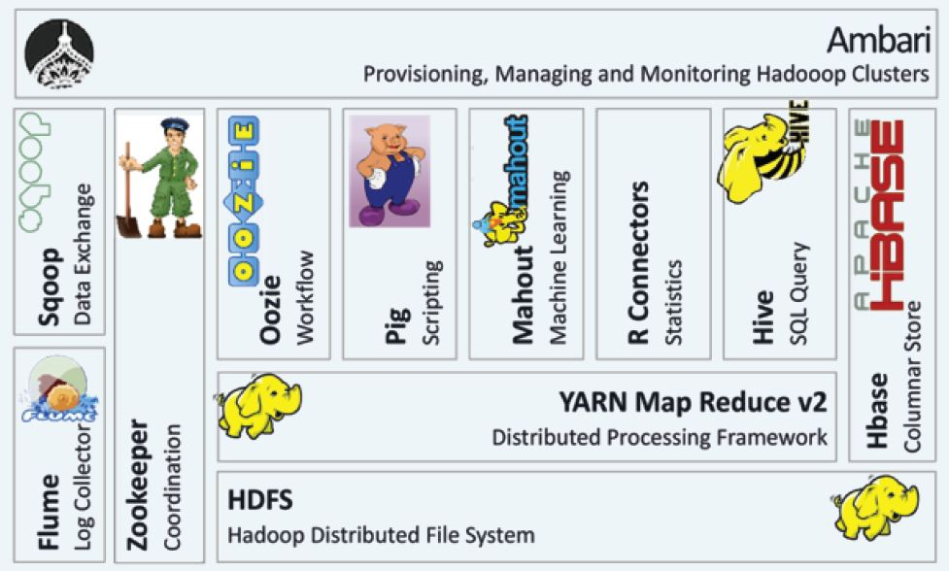
HADOOP ECOSYSTEM
Notes:
ksoong.org/assets/blog/Hadoop-Echosystem.jpg

